Slide 1
Topics
Access Modifiers in Java (https://docs.oracle.com/javase/tutorial/java/javaOO/accesscontrol.html)

Slide 2
What are Access Modifiers
Helps the programmer to decide access levels for the instance fields and methods of the class
Encapsulation is supported via Access Modifiers
Scope/Visibility/Access Privileges of the ‘Instance Fields’ and ‘Methods’ of a class is determined via their Access Modifiers
Java Provides following
public (Highest Access/Privilege Level )
protected
private (Least Privilege Level)
package-private (Default Modifier – if no access modifier is used)
Note: package-private is not a Java Keyword.

Slide 3
A Simple Example
class Student
{
private String name; // name of student (Access Level : private)
int age; // age of student (Access Level: package-private)
protected String idno; // id number of student ( Access Level : protected)
public String getName()
{
return name;
}
public void display()
{
System.out.println(“Name :”+ name);
System.out.println(“Age : “+ age);
}
}// End of class Student
Decreasing Access Level
Highest Access Level
Lowest Access Level
public
protected
package-private
private

Slide 4
Access Locations
Places from where a member of class can be accessed/referenced
Five Possible Access Locations
From within a class itself
From other classes in the same package
From sub-classes defined with-in the same package
From sub-classes defined in some other packages
From classes defined in other packages

Slide 5
Access Locations : Example
Consider the Following Package Hierarchy
PackA
B1,B2,B3
PackB
PackX
X1,X2,X3
PackC
PackD
PackY
PackZ
C1,C2
D1,D2
Y1,Y2
Z1,Z2
B1,B2 and B3 are classes in package PackB. Similarly classes X1,X2 and X3 belongs to package PackX. C1,C2 classes belongs to PackC. D1,D2 classes belongs to PackD.Y1,Y2 classes belongs to PackY. Z1,Z2 and Z3 classes belongs to classes PackZ.
Assume class B3 (package PackB) is a sub-class of B1 (package PackB).
Assume class Z2 (package PackZ) is a sub-class of B2 (package PackB).

Slide 6
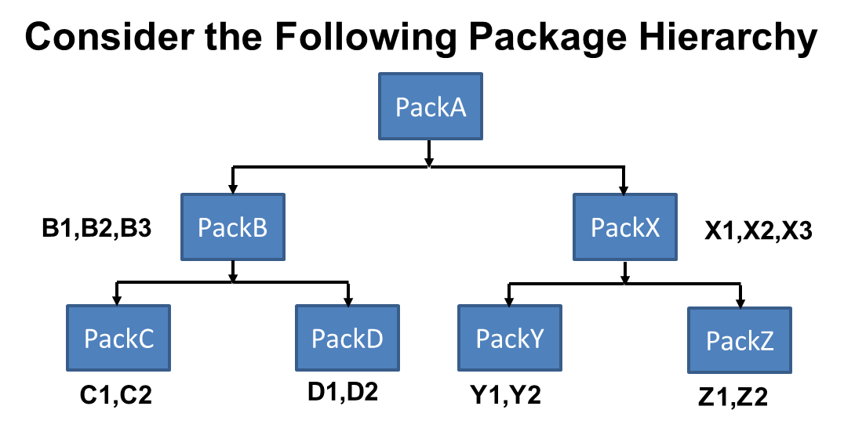
Access Locations : Example
B1
<<super class>>
B2
<<super class>>
B3
<<sub class>>
Z2
<<sub class>>
B1 and B3 belongs to
Same Package PackB
B2 belongs to Package Pack B
Z2 belongs to Package PackZ

Slide 7
Visibility of Fields/Methods
Access Modifiers
 | public | protected | package- private | private
With in the Same Class
Sub-Classes in same package
Other Classes in same package
Subclasses in other packages
Non-subclasses in other packages
Access Locations

Slide 8
Visibility of Fields/Methods
Access Modifiers
 | public | protected | package- private | private
With in the Same Class | Yes | Yes | Yes | Yes
Sub-Classes in same package
Other Classes in same package
Subclasses in other packages
Non-subclasses in other packages
Access Locations

Slide 9
Visibility of Fields/Methods
Access Modifiers
 | public | protected | package- private | private
With in the Same Class | Yes | Yes | Yes | Yes
Sub-Classes in same package | Yes | Yes | Yes | No
Other Classes in same package
Subclasses in other packages
Non-subclasses in other packages
Access Locations

Slide 10
Visibility of Fields/Methods
Access Modifiers
 | public | protected | package- private | private
With in the Same Class | Yes | Yes | Yes | Yes
Sub-Classes in same package | Yes | Yes | Yes | No
Other Classes in same package | Yes | Yes | Yes | No
Subclasses in other packages
Non-subclasses in other packages
Access Locations

Slide 11
Visibility of Fields/Methods
Access Modifiers
 | public | protected | package- private | private
With in the Same Class | Yes | Yes | Yes | Yes
Sub-Classes in same package | Yes | Yes | Yes | No
Other Classes in same package | Yes | Yes | Yes | No
Subclasses in other packages | Yes | Yes | No | No
Non-subclasses in other packages
Access Locations

Slide 12
Visibility of Fields/Methods
Access Modifiers
 | public | protected | package- private | private
With in the Same Class | Yes | Yes | Yes | Yes
Sub-Classes in same package | Yes | Yes | Yes | No
Other Classes in same package | Yes | Yes | Yes | No
Subclasses in other packages | Yes | Yes | No | No
Non-subclasses in other packages | Yes | No | No | No
Access Locations

Slide 13
Access Modifiers : Summary
<<private> members of a class say ‘C’ are visible only in side the class ‘C’
<<package-private>> members of class ‘C’ are visible in the all the classes of the package to which the class ‘C’ belongs
<<protected>> members of class ‘C’ are visible in (i) all the classes of the package to which the class ‘C’ belongs and (ii) all the sub-classes of ‘C’
<<public>> members of class ‘C’ are visible to every other class belonging to the same or any other package
Decreasing Access Level
Highest Access Level
Lowest Access Level
public
protected
package-private
private

Slide 14
Thank You

